Slide 1
“Development of a script-based package for analysis of work hardening behaviour”
Abhinav Garg (17118002)
Aman Sharma (17118013)
Supervised by – Dr Sumeet Mishra

Slide 2
INTRODUCTION
Work hardening analysis of a material forms a foundation of further research in plasticity
Calculation of parameters like yield strength, Young’s modules etc. is a prerequisite before one can proceed with their main objectives
However, all these parameters were calculated semi-manually
Since these parameters were utterly important, we decided to automate this process

Slide 3
OBJECTIVE
Create Jupyter notebook which automates the following:
Identify Young’s Modulus, Yield Strength, and Ultimate Tensile Strength.
Separate the plastic region
Return a work hardening plot
Fit different dislocation-density based model
Plot the YLD2000 yield criterion

Slide 4
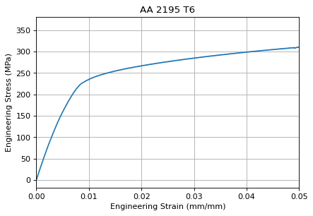
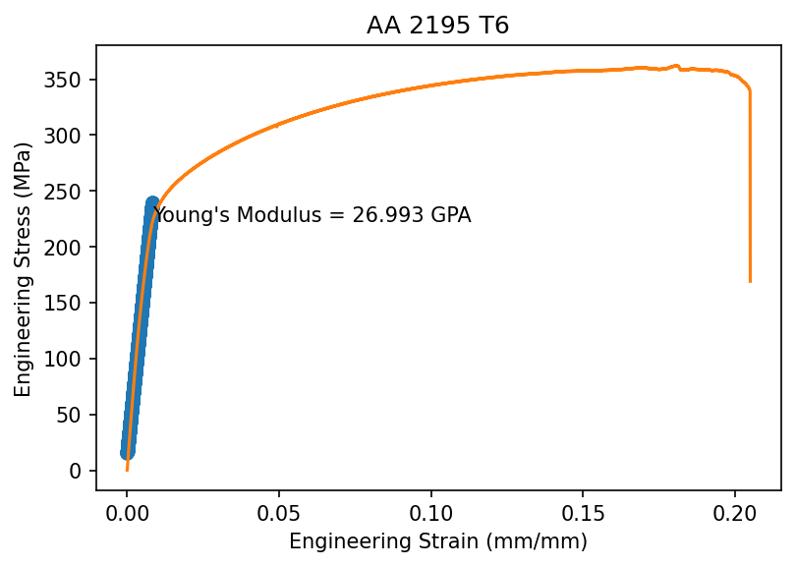
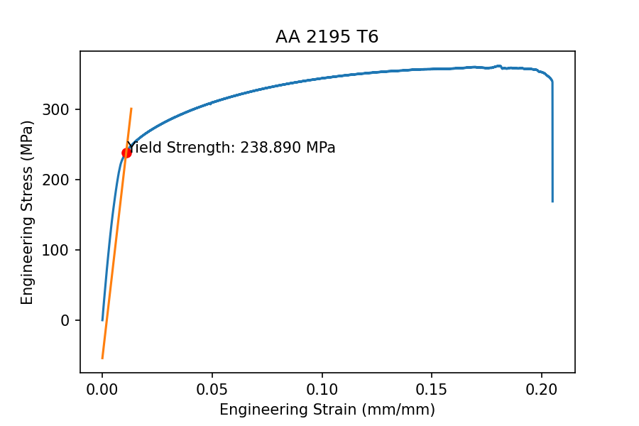
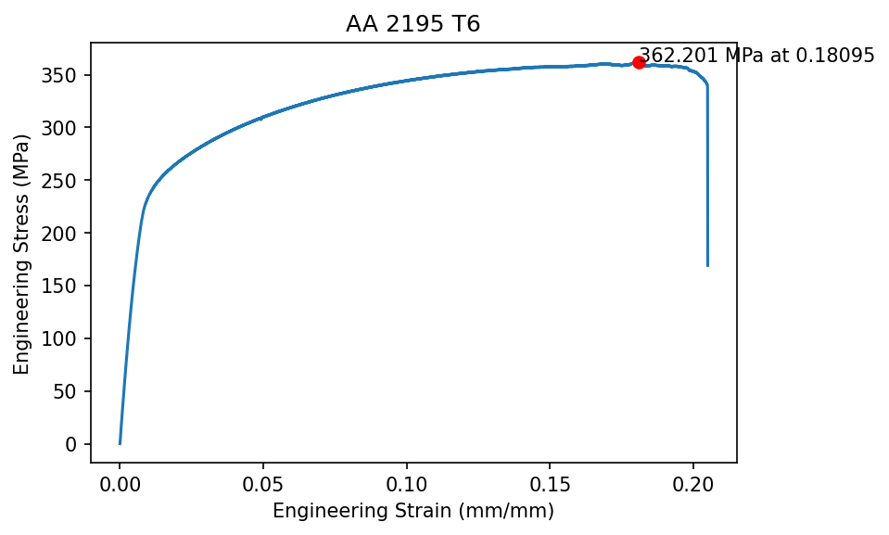
BASIC PREREQUISITES

Slide 5
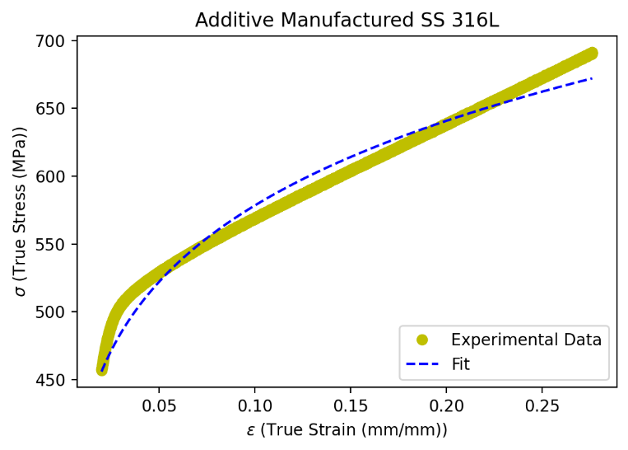

HOLLOMON EQUATION
$$σ=Kε^{n}$$
1. It tends to predict infinite strength for materials being tested.
2. It does not provide information about the microstructure.
Parameter | Value
K | 812.9174 MPa
n | 0.15

Slide 6
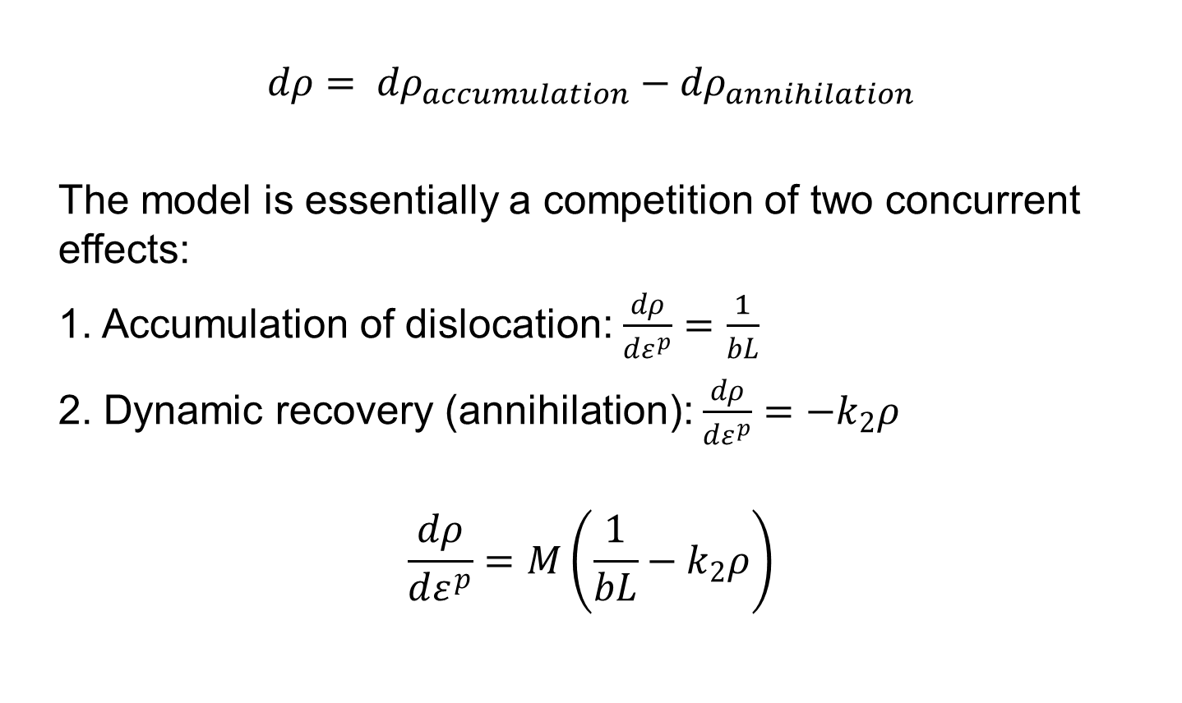
KOCKS-MECKING THEORY
$$dρ= {dρ}_{accumulation}−{dρ}_{annihilation}$$
The model is essentially a competition of two concurrent effects:
1. Accumulation of dislocation: $\frac{dρ}{dε^{p}}=\frac{1}{bL}$
2. Dynamic recovery (annihilation): $\frac{dρ}{dε^{p}}={−k}_{2}ρ$
$$\frac{dρ}{dε^{p}}=M\left(\frac{1}{bL}−k_{2}ρ\right)$$

Slide 7
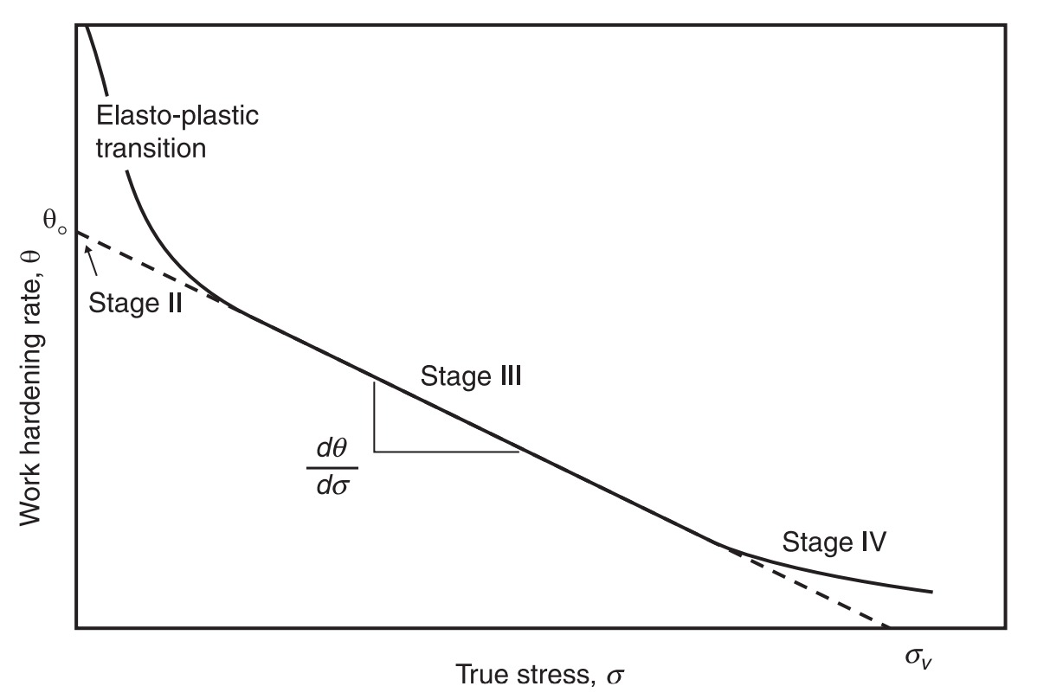
A TYPICAL KOCKS-MECKING PLOT

Slide 8
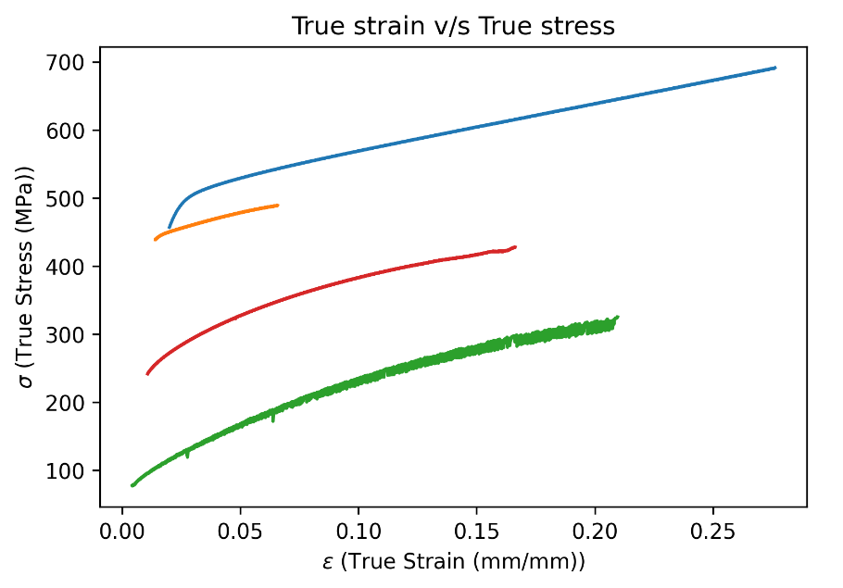
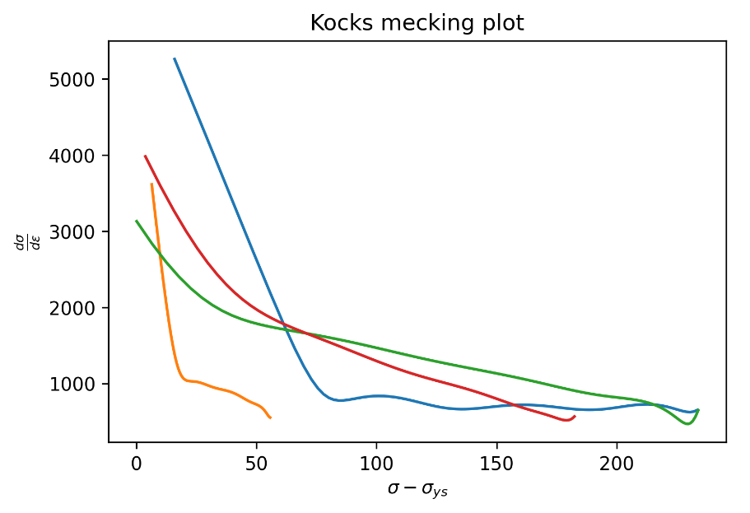
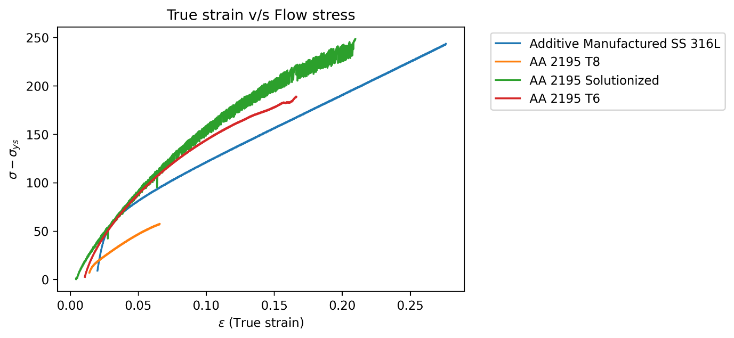
IMPLEMENTATION OF THE KOCKS-MECKING MODEL

Slide 9
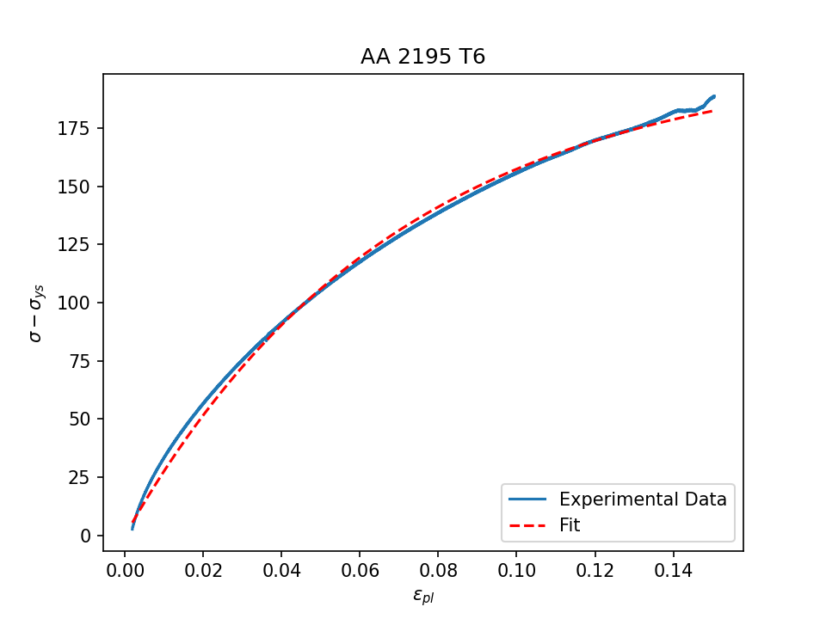


COARSE GRAINED FOREST DISLOCATION DENSITY-BASED MODEL
Implementation of Kocks-Mecking Model for single phase and coarse-grained materials (T6 in our case).
Since, $\sqrt{ρ} α \frac{1}{L}$
$\frac{dρ}{dε^{p}}=M\left(k_{1}\sqrt{ρ}−k_{2}ρ\right)$
$σ= σ_{s}\left(1−e^{\frac{θ_{0}}{σ_{s}}ε_{pl}}\right)$
(Voce equation)
$$σ_{s}=205.88 Mpa$$ $θ_{0}=2978.47 MPa$
Solving the equation

Slide 10
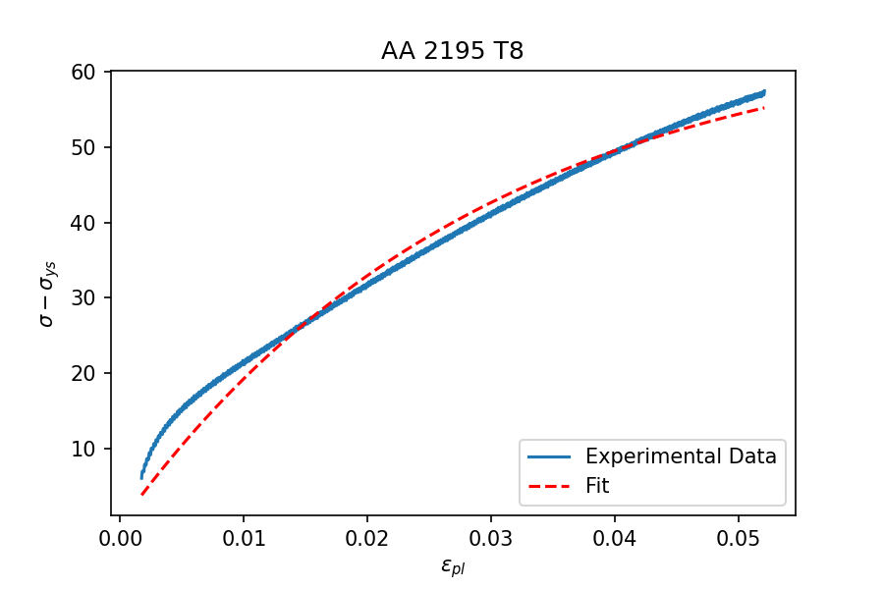
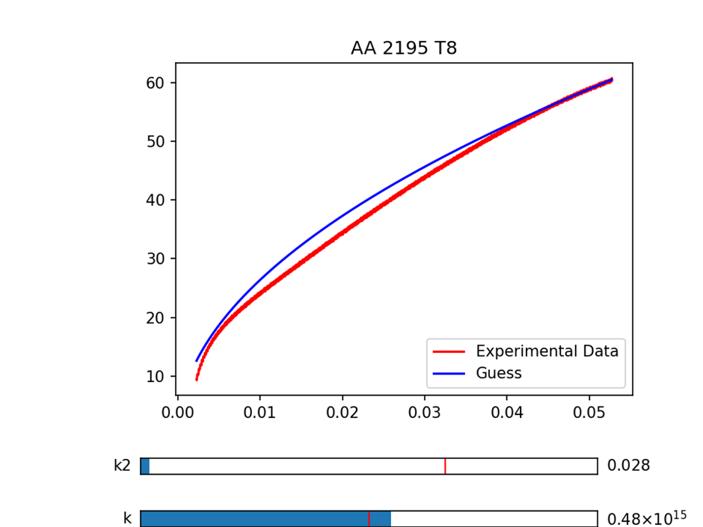
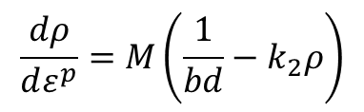
GEOMETRIC OBSTACLE MODEL
Materials where spacing between dislocations is small.
$$\frac{dρ}{dε^{p}}=M\left(\frac{1}{bd}−k_{2}ρ\right)$$
Inaccurate fitting of Voce equation.

Slide 11
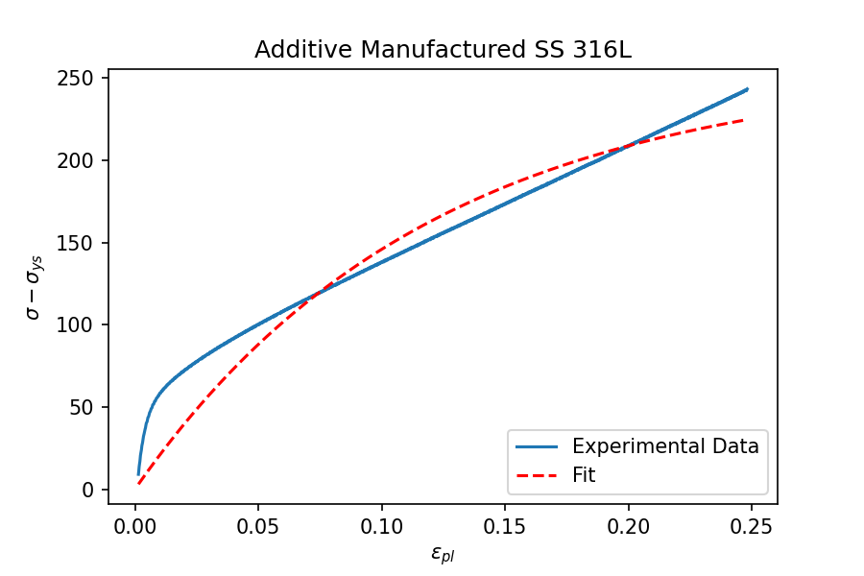
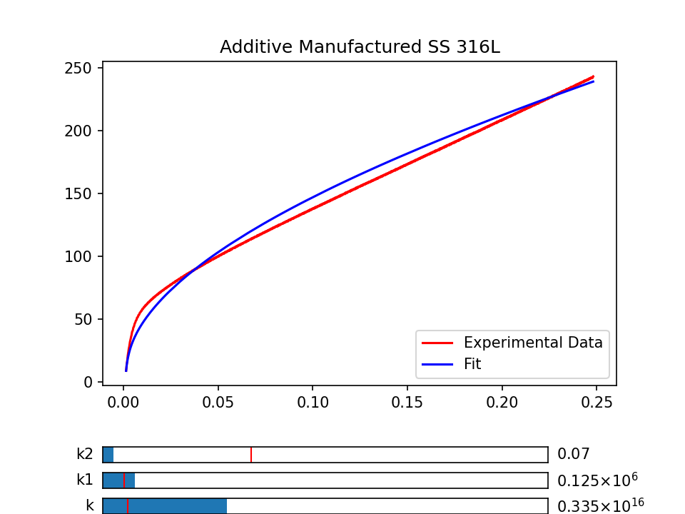
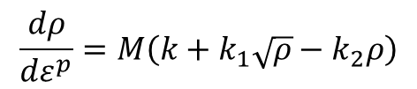
HYBRID MODEL
This model combines the previous two models and gives the equation:
$$\frac{dρ}{dε^{p}}=M\left(k+k_{1}\sqrt{ρ}−k_{2}ρ\right)$$
Inaccurate fitting of Voce equation

Slide 12

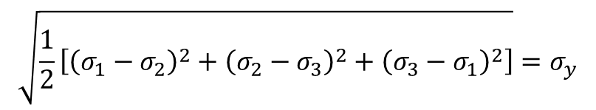
ISOTROPIC YIELD CRITERION
TRESCA
$$σ_{1}−σ_{3} {=σ}_{y}$$
VON MISES
$$\sqrt{\frac{1}{2}\left[{\left(σ_{1}−σ_{2}\right)}^{2}+{\left(σ_{2}−σ_{3}\right)}^{2}+{\left(σ_{3}−σ_{1}\right)}^{2}\right]}{=σ}_{y}$$
The major drawback of these methods is that they can be applied to isotropic materials only
Notes:
Tresca: Yield occurs when the maximum shear stress is equal to the shear stress at yielding in a uniaxial tensile test
Von mises: Yield occurs when the maximum distortion energy is equal to the distortion energy at yielding in a uniaxial tensile test

Slide 13
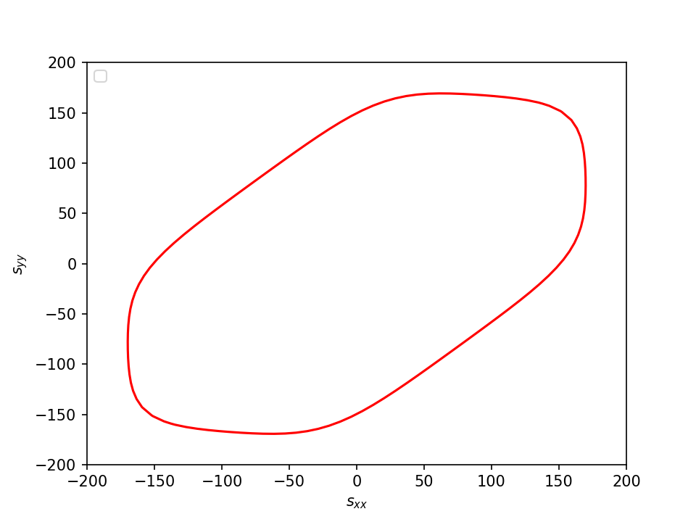

BARLAT YLD2000 CRITERIA
Barlat proposed a series of models accounting for materials exhibiting planar anisotropy. Out of which the most popular was Yld2000-2d.
$$∅= ∅^{′}+∅^{′′}=2{\overline{σ}}^{a}$$
$\begin{aligned}2{\overline{σ}}^{a}= {\left|s_{xx}\left(\frac{2α_{1}+α_{2}}{3}\right)+ s_{yy}\left(\frac{2α_{2}+α_{1}}{3}\right)\right|}^{a}+ \\ {\left|s_{xx}\left(\frac{2α_{3}−{2α}_{4}}{3}\right)+ s_{yy}\left(\frac{4α_{4}−α_{3}}{3}\right)\right|}^{a}+ {\left|s_{xx}\left(\frac{4α_{5}−α_{6}}{3}\right)+ s_{yy}\left(\frac{2α_{6}−{2α}_{5}}{3}\right)\right|}^{a}\end{aligned}$

Slide 14

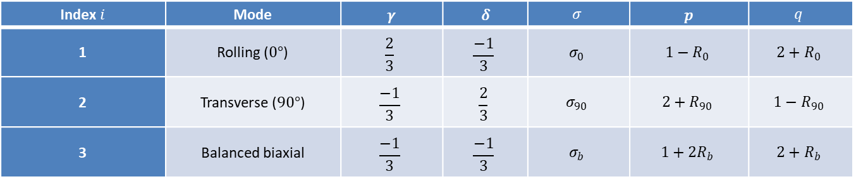
COMPUTATION OF ANISOTROPIC PARAMETERS
$\begin{aligned}G_{i}=\left(α_{1}p_{i}+α_{2}q_{i}\right)\operatorname{sgn}\left(α_{1}γ_{i}−α_{2}δ_{i}\right){\left|α_{1}γ_{i}−α_{2}δ_{i}\right|}^{a−1} \\ +\left(α_{3}p_{i}−{2α}_{4}q_{i}\right)\operatorname{sgn}\left(α_{3}γ_{i}+{2α}_{4}δ_{i}\right){\left|α_{3}γ_{i}+{2α}_{4}δ_{i}\right|}^{a−1} \\ +\left({2α}_{5}p_{i}−α_{6}q_{i}\right)\operatorname{sgn}\left({2α}_{5}γ_{i}+α_{6}δ_{i}\right){\left|{2α}_{5}γ_{i}+α_{6}δ_{i}\right|}^{a−1}\end{aligned}$
$$F_{i}={\left|α_{1}γ_{i}−α_{2}δ_{i}\right|}^{a}+{\left|α_{3}γ_{i}+{2α}_{4}δ_{i}\right|}^{a}+\left|{2α}_{5}γ_{i}+α_{6}δ_{i}\right|−2σ_{i}^{a}$$
3 stress states – RD, TD, and balanced biaxial
Index $i$ | Mode | 𝛾 | 𝛿 | $$σ$$ | 𝑝 | $$q$$
1 | Rolling ($0°$) | $$\frac{2}{3}$$ | $$\frac{−1}{3}$$ | $$σ_{0}$$ | $$1−R_{0}$$ | $$2+R_{0}$$
2 | Transverse ($90°$) | $$\frac{−1}{3}$$ | $$\frac{2}{3}$$ | $$σ_{90}$$ | $$2+R_{90}$$ | $$1−R_{90}$$
3 | Balanced biaxial | $$\frac{−1}{3}$$ | $$\frac{−1}{3}$$ | $$σ_{b}$$ | $$1+{2R}_{b}$$ | $$2+R_{b}$$

Slide 15
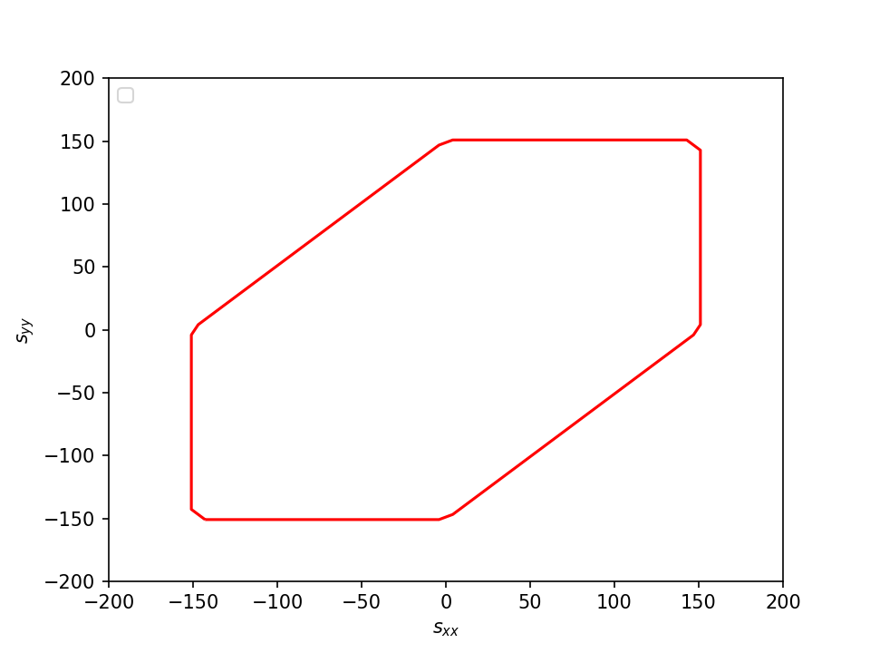
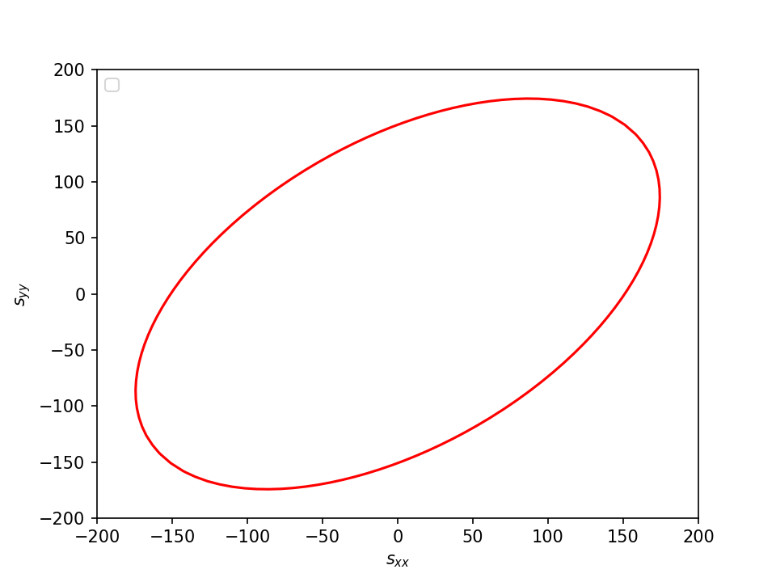


YLD2000: A GENERAL CASE
Barlat YLD2000 is a more generalised model as depicted below.
Tresca criteria
Von Mises criteria
All $α$ are equal and a = 1
All $α$ are equal and a = 2

Slide 16
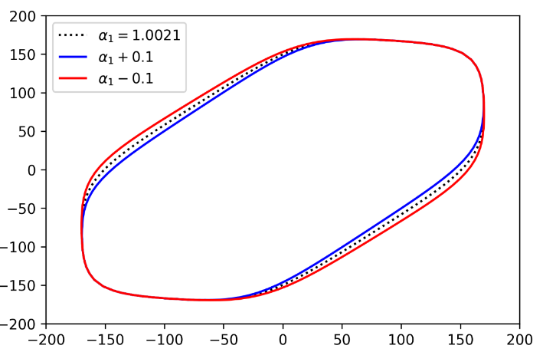

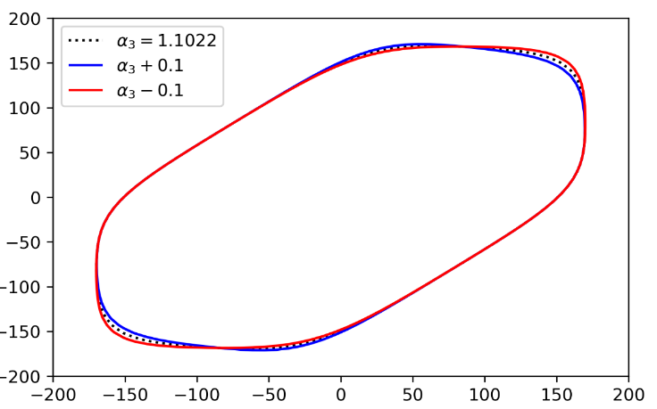
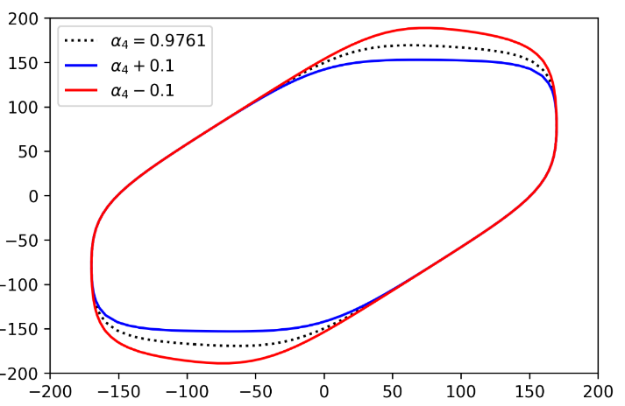
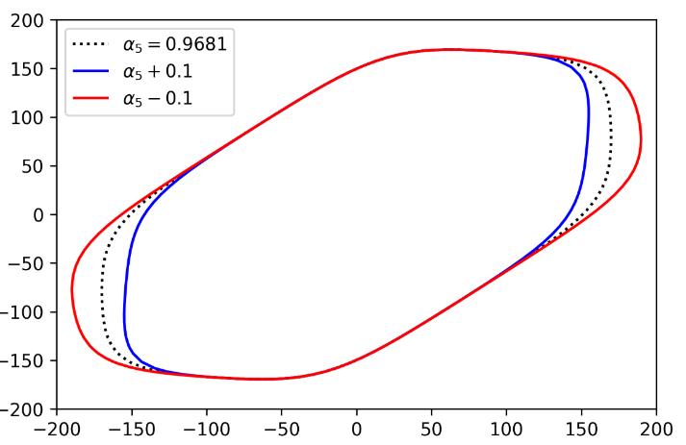
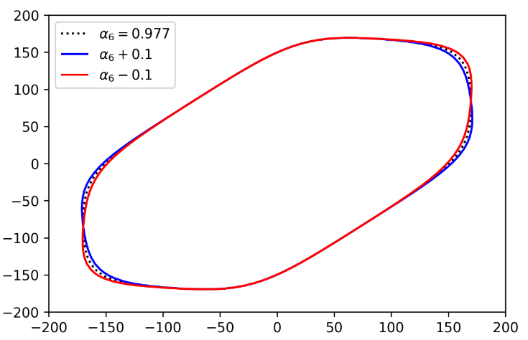
GRAPHICAL SIGNIFICANCE OF ANISTROPC PARAMETERS

Slide 17
CONCLUSION
All of our implementations have been hosted on the GitHub repository.
The yield criterion which we calculated using the Barlat YLD2000 method can be further used in the future to draw Formability Limit Diagram which has great significance in the world of industrial metallurgy.

Slide 18
THANK YOU

